Slide 1
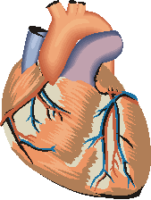
Genetic syndromes Involving the Heart
Steven H. Todman, M.D.
Assistant Professor
Pediatric Cardiology
LSUHSC-Shreveport

Slide 2
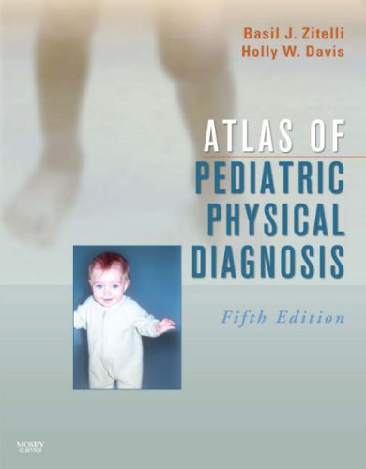
Goals and Objectives
To review common genetic syndromes associated with CHD in an interactive case-based format
Focus on high-yield images

Slide 3
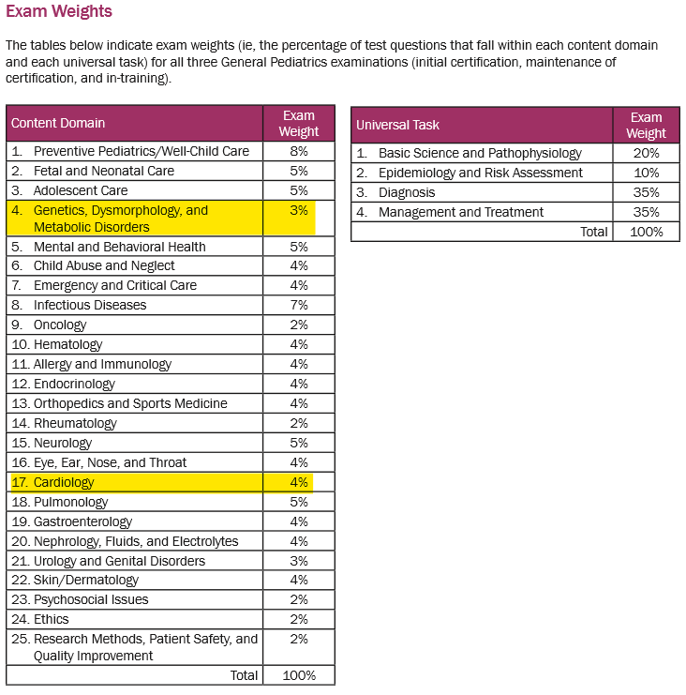

Slide 4
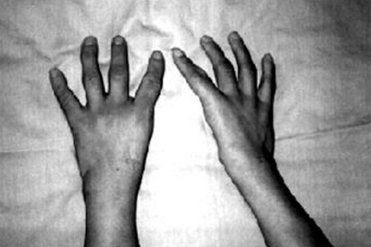
Case #1
Ten year-old girl presents for WCC
PE: Missing thumbs on both hands
CV: Widely split fixed S2, a 2/6 SEM at the ULSB, and a 1/6 short mid-diastolic murmur at the LLSB

Slide 5
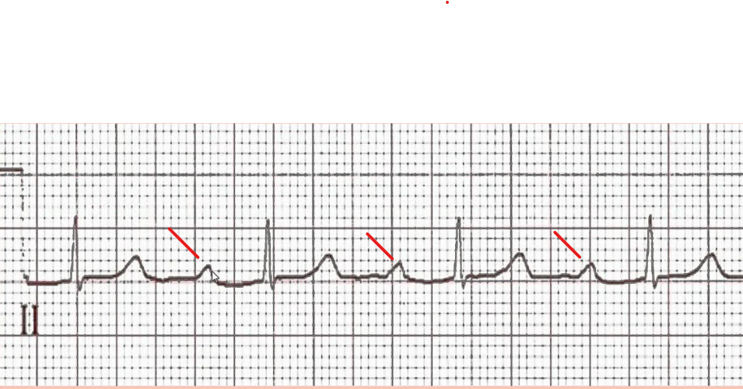
Case #1
FHx – Different members of the family with heart murmurs, radial anomalies, and cardiac conduction defects

Slide 6
What is the most likely cardiac defect?
(A) ASD
(B) VSD
(C) PDA
(D) Tetralogy of Fallot
(E) Dextrocardia, TGA, and IAA

Slide 7
Which of the following is the most likely genetic syndrome?
(A) VACTERL
(B) Holt-Oram
(C) Pulmonary Atresia with multiple collaterals
(D) Kabuki
(E) Marfan

Slide 8
Holt-Oram
Typically Autosomal Dominant
TBX5 gene mutation
Preaxial radial ray abnormalities of upper limbs
Severe (phocemelia) or more mild (hypoplasia) of involved bones
Cardiac conduction defects can be present

Slide 9
Case #2
Hx – 1 year-old boy with mild mental retardation and 2 day Hx of URI symptoms
PE - 5/6 SEM URSB
BP 107/60 mm Hg
Calcium is 12mg/dL

Slide 10
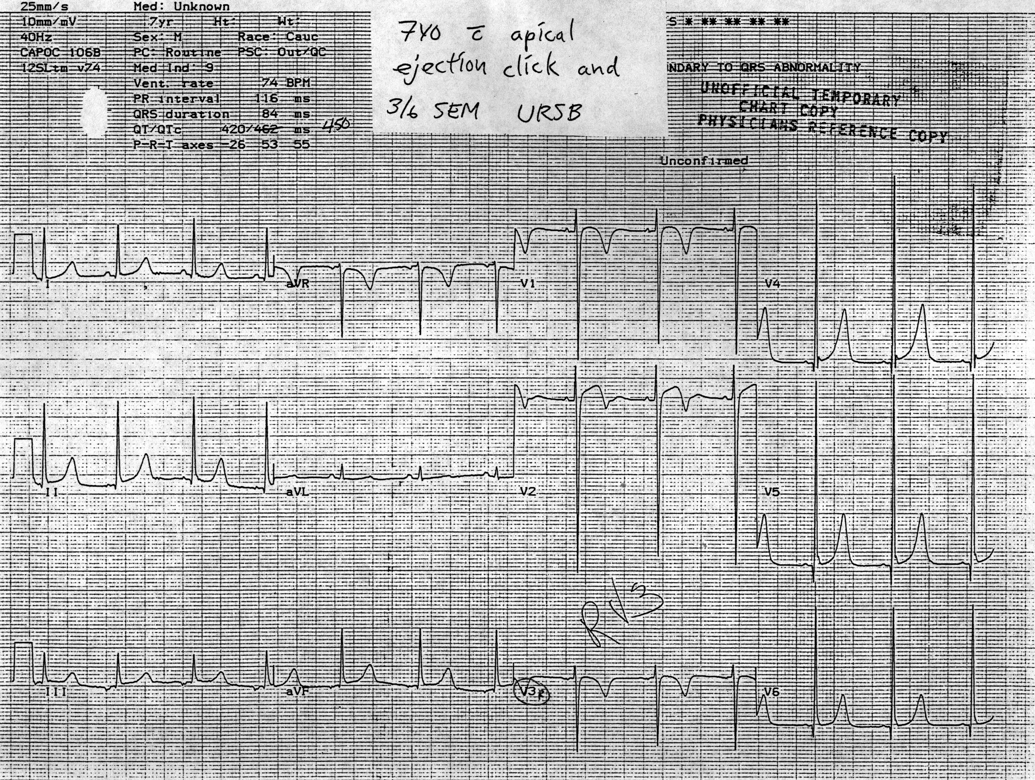
EKG reveals the following abnormality

Slide 11
What is the most likely cardiac diagnosis?
(A) ASD
(B) VSD
(C) PDA
(D) PS
(E) AS
(F) Innocent murmur

Slide 12
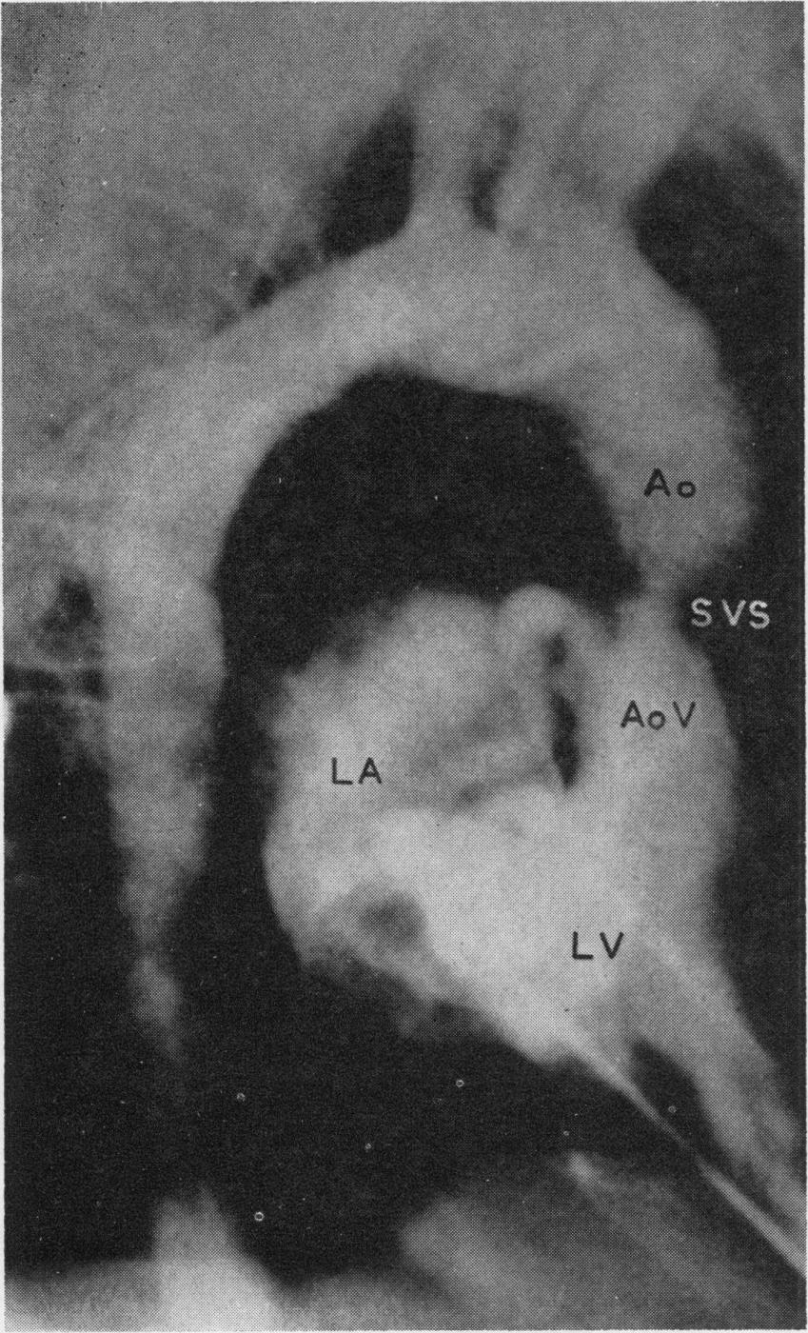
Williams, JCP, Barratt, BG, et al.. SAS. Circulation. 1961;24:1311-1318

Slide 13
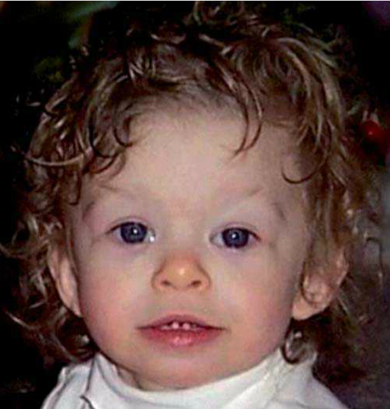
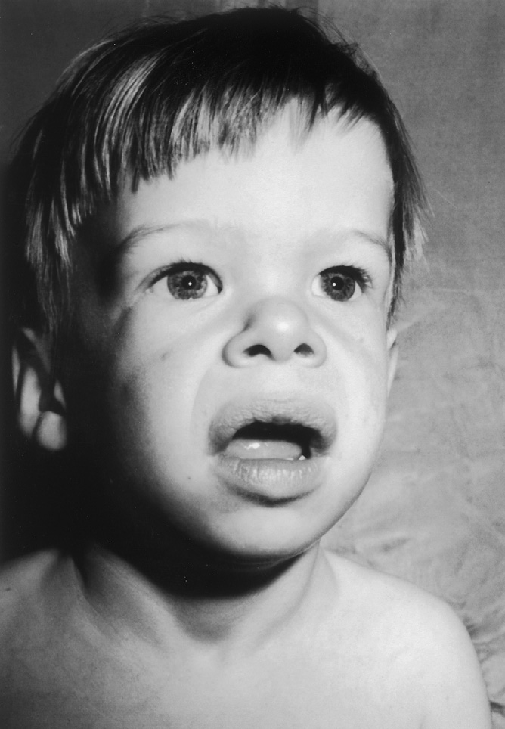

Slide 14
Your diagnosis?
(A) Williams syndrome
(B) Kabuki syndrome
(C) Alagille syndrome
(D) Wolf-Hirschhorn Syndrome
(E) Trisomy 21

Slide 15
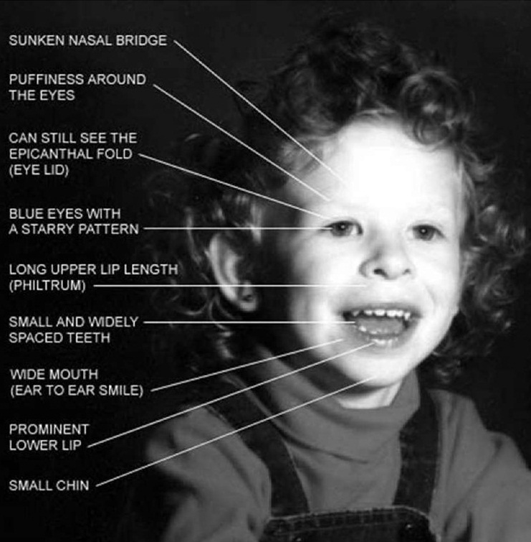

Williams Syndrome
Elastin gene disruption involving chromosome 7

Slide 16
Stellate iris
Short nose with bulbous nasal tip
Flat nasal bridge
Prominent full cheeks
Long philtrum
Wide mouth
Mild micrognathia
Triangular facies

Slide 17
Williams Syndrome
Cardiac manifestations include
Supravalvar aortic stenosis
Supravalvar pulmonary stenosis
Peripheral branch pulmonary artery stenosis
Renal artery stenosis
Systemic hypertension

Slide 18
Williams Syndrome
Variable mental retardation
Delayed speech acquisition, followed by excessive talking, and overfriendly behavior (“cocktail party” persona), hyperacusis
Behavioral problems –ADHD, Anxiety
Hypercalcemia

Slide 19
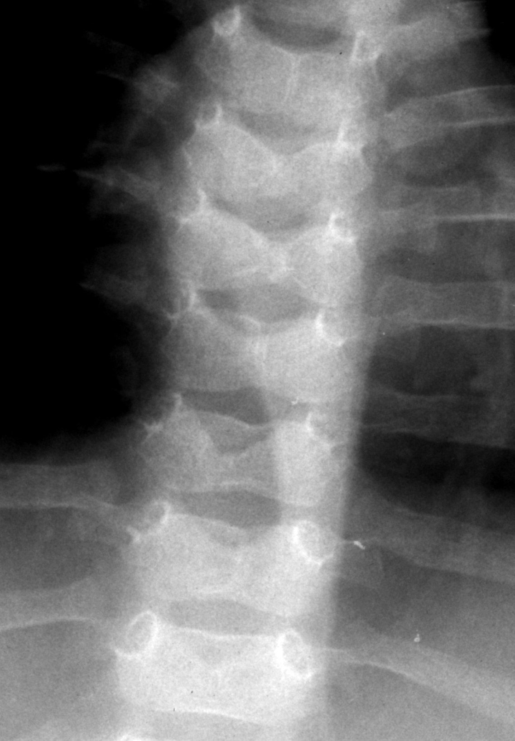
Case #3
7 year-old girl with a systolic murmur at the left and right axilla and back
Hypercholesterolemia
Butterfly-like vertebral arch defects
Mild mental retardation
Growth restriction

Slide 20


Slide 21
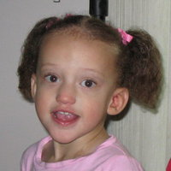

Slide 22
Broad prominent forehead
Deep-set,widely spaced eyes
Long straight nose
Underdeveloped mandible

Slide 23
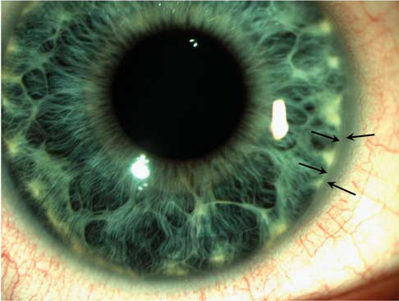
Posterior embryotoxin at the junction of the iris and cornea

Slide 24
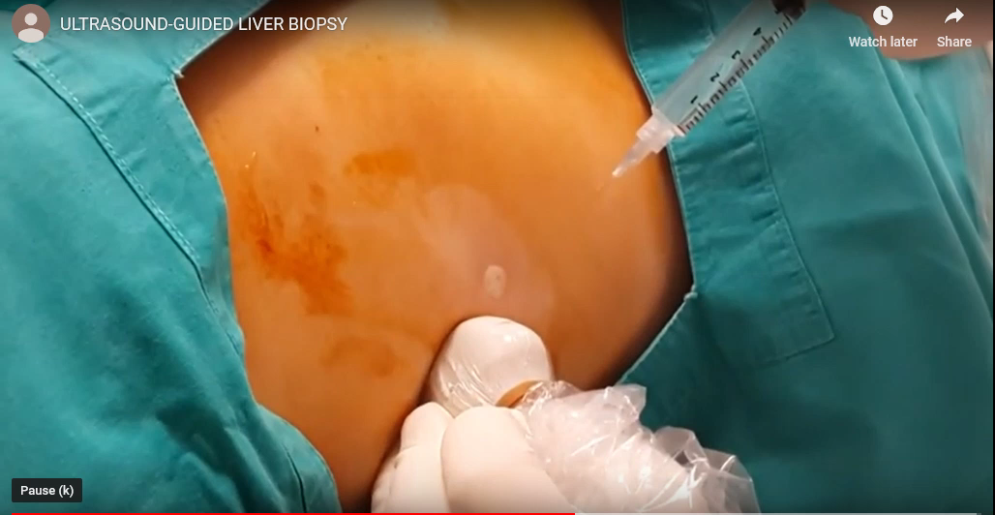
Liver biopsy
Paucity of interlobular bile ducts
Cholestasis in hepatocytes and canaliculi

Slide 25
Which of the following is the most likely genetic syndrome?
(A) Noonan’s syndrome
(B) Cri-du-chat
(C) Angelman Syndrome
(D) Alagille Syndrome
(E) Apert Syndrome

Slide 26
Alagille Syndrome
Most patients present with neonatal jaundice
Cholestasis develops in patients up to 3 years
AD - JAG1(90%)

Slide 27
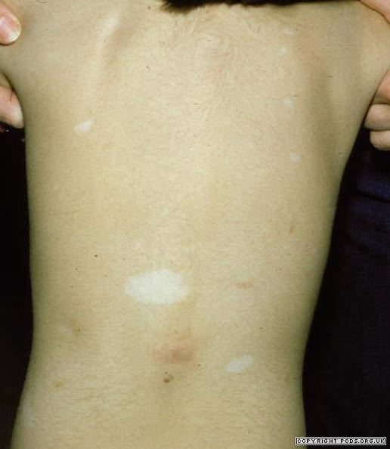
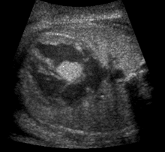
Case #4
3 y/o with seizures, hypopigmented macules and developmental delay
Prenatal echocardiogram demonstrates tumors in the heart

Slide 29
What is the usual course of these cardiac masses?
(A) Progress in size
(B) Regress in size
(C) Result in obstruction in cardiac output
(D) Require surgical excision

Slide 30
Which of the following is the most likely genetic diagnosis?
(A) Waardenburg syndrome
(B) Treacher Collins
(C) Sturge Webber
(D) Smith-Lemli-Opitz
(E) Tuberous Sclerosis

Slide 31
Tuberous Sclerosis
AD – TSC2 (~70%), TSC1 (~26%)

Slide 32
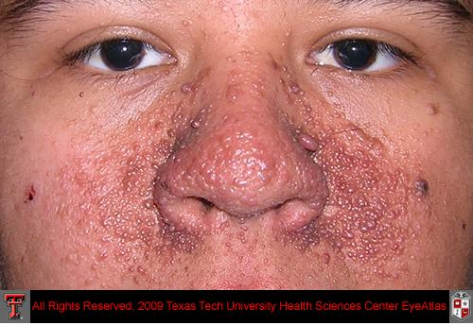
Adenoma Sebaceum

Slide 33

White ash-leaf spots
Present in 90% of cases, common on trunk and buttocks

Slide 34
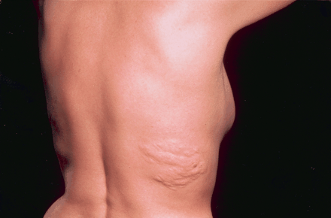
Shagreen Patch
A form of collagenoma
Elevated discolored skin commonly observed over lumbosacral region (~21%)

Slide 35
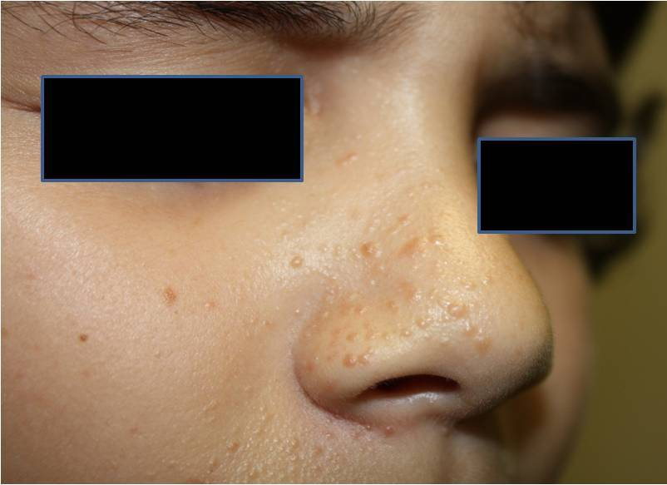
Facial Angiofibroma
Red/Brown nodules over nose and cheeks

Slide 36
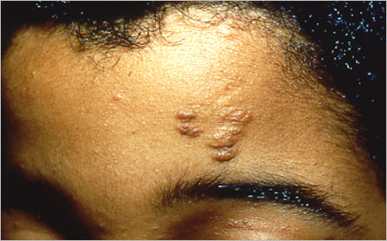
Forehead fibrous plaque – yellowish-brown or skin-colored plaque

Slide 37
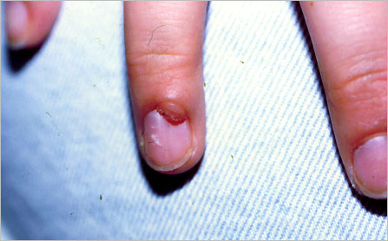
Periungual fibroma

Slide 38
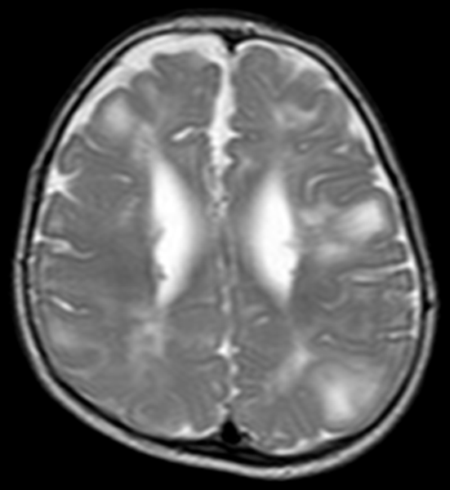
CNS Abnormalities
Subependymal nodules (~80%)
Cortical dysplasias
Subependymal giant cell astrocytomas
80% have seizures
Autism (20-60%)
ADHD (20-50%)

Slide 39
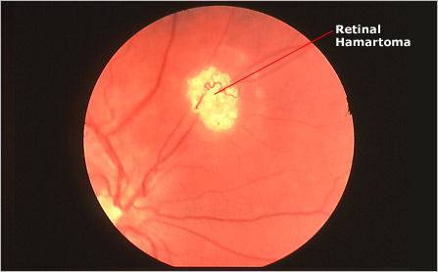
Retinal Hamartoma
30-50%

Slide 40
Case #5
18 year-old male with pectus carinatum, flat feet, and pneumothorax
CV: Mid-systolic click, followed by a 3/6 apical systolic murmur.
History of lens subluxation.

Slide 41
What is the most likely congenital heart defect?
(A) Aortic stenosis
(B) Pulmonary stenosis
(C) Coarctation of the Aorta
(D) Pericarditis
(E) Mitral valve prolapse with regurgitation

Slide 42
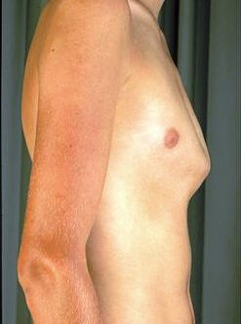

Slide 43
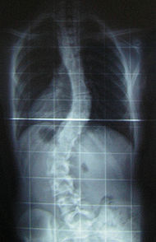
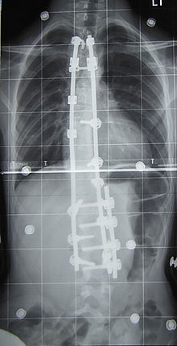

Slide 44
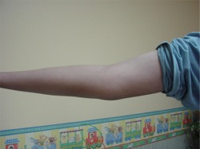
Reduced extension of the elbows (<170 °)

Slide 45
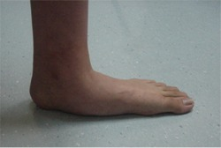
Medial displacement of the medial malleolus, causing pes planus

Slide 46
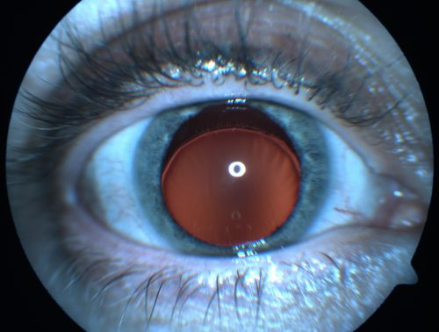
Ectopia Lentis

Slide 47
Which of the following is the best diagnosis?
(A) Marfan syndrome
(B) Treacher Collins
(C) Sturge Webber
(D) Smith-Lemli-Opitz
(E) Neurofibmatosis

Slide 48
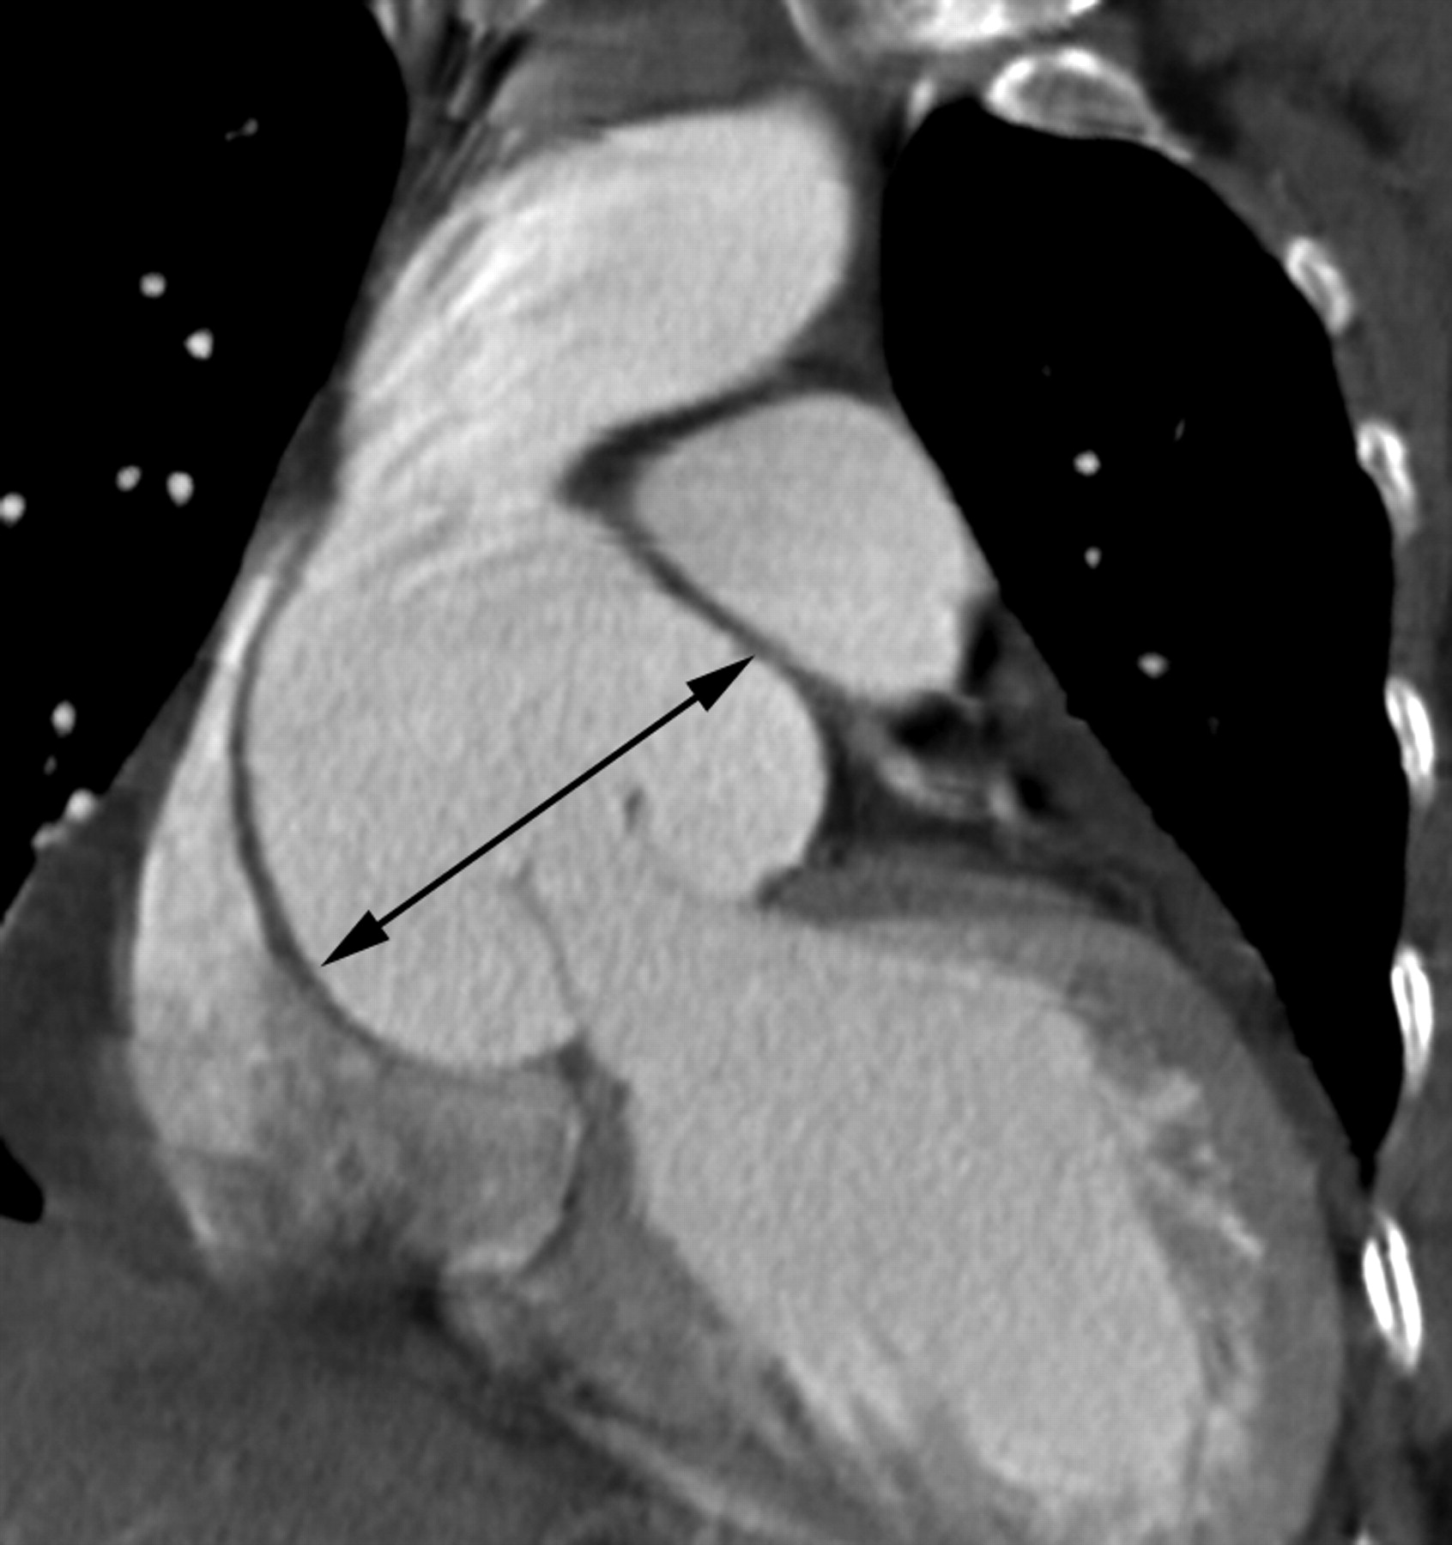
\
Ha H I et al. Radiographics 2007;27:989-1004
©2007 by Radiological Society of North America

Slide 49
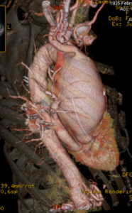

Slide 50
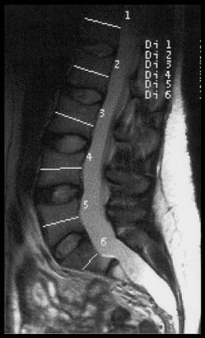
Lumbosacral dural ectasia
(stretching of dural sac)

Slide 51
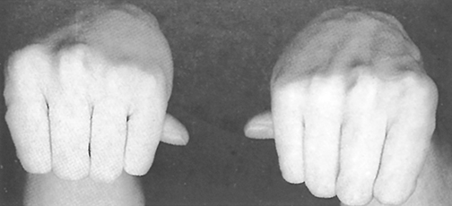
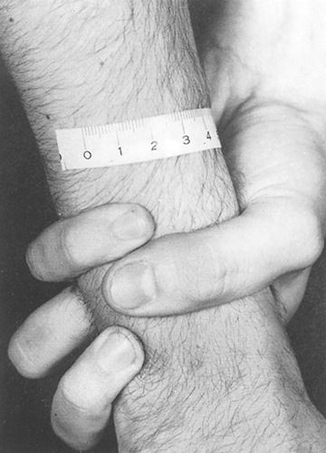

Slide 52
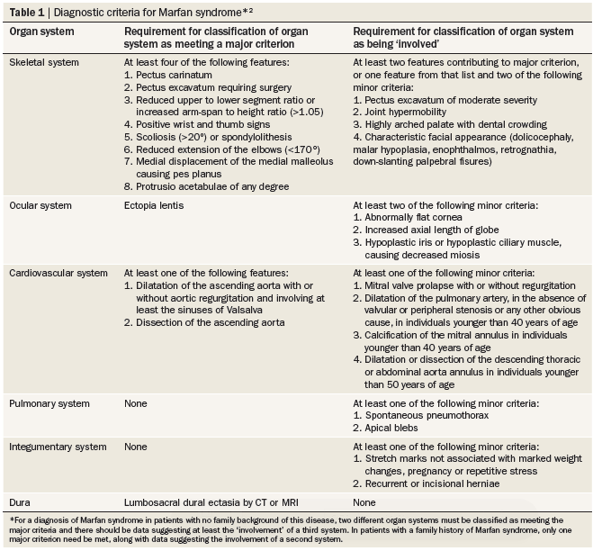

Slide 53
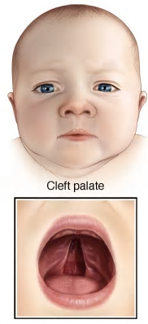
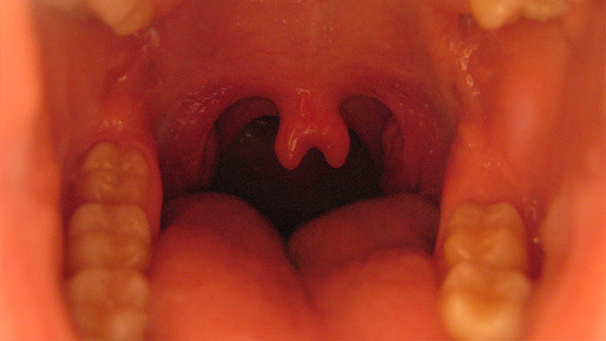
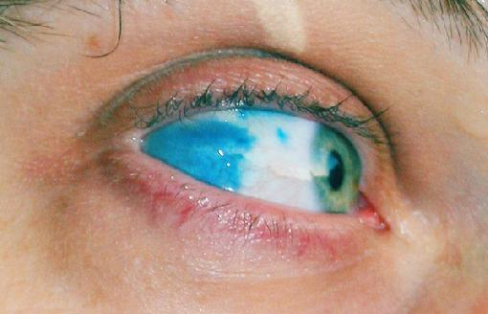
What if your “Marfan syndrome” patient had…..

Slide 54
Loeys-Dietz syndrome

Slide 55
Case #6
4 month old “dysmorphic boy” presents for WCC
Patient is undernourished, tachycardic and tachypneic.
3/6 holosystolic murmur along LLSB, and mid-diastolic rumble.
Hepatomegaly

Slide 56
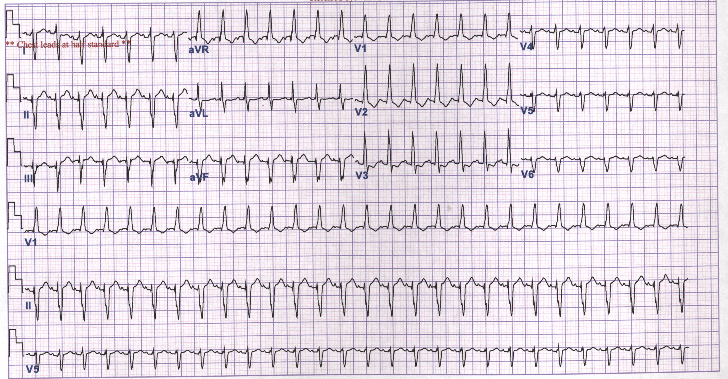
EKG demonstrates this abnormality

Slide 57
Which of the following is the best diagnosis?
(A) McCune-Albright
(B) Treacher Collins
(C) Sturge Webber
(D) Trisomy 21
(E) Neurofibmatosis

Slide 58
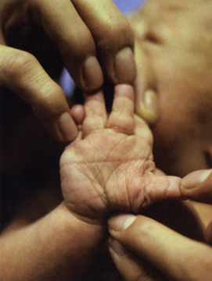
Your Diagnosis
Trisomy 21

Slide 59
Trisomy 21
Typical physical phenotype due to an extra copy of the proximal part of 21q22
Types of Trisomy 21
94% Full trisomy 21
2.4% Mosaicism
3.3% Translocation

Slide 60
Short stature
Hypotonia
Moderate-to-severe mental retardation
Sleep apnea

Slide 61
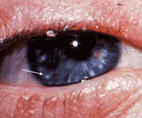
Brushfield spots
Refractive errors (50%)
Strabismus (44%)
Nystagmus (20%)

Slide 62
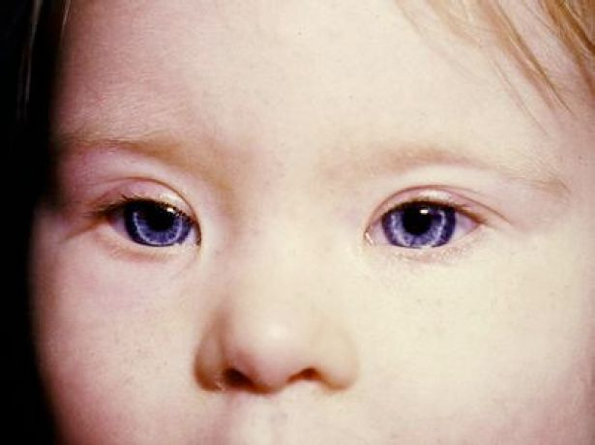
Upslanting palpebral fissures
Flat nasal bridge
Partial adontia or microdontia (50%)

Slide 63
Trisomy 21
Ears – small, over-folded helix
Hearing loss is common
Neck – Atlantoaxial instability

Slide 64
Trisomy 21
40-50% of patients will have congenital heart disease
43% AV canal
32% VSD

Slide 65
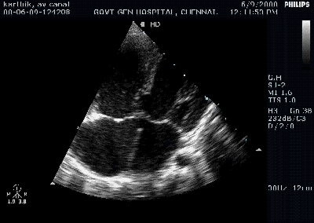

Slide 66
Trisomy 21
GI/Abdomen
Diastasis recti
Umbilical hernia
Duodenal atresia
Hirschprung disease
TE fistula

Slide 67
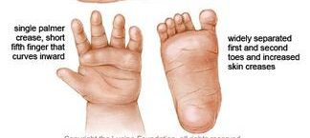

Slide 68
Trisomy 21
Endocrine
Hypothyroid
Diabetes
Hematologic
Neonatal leukemoid reaction
Increased risk of leukemia

Slide 69
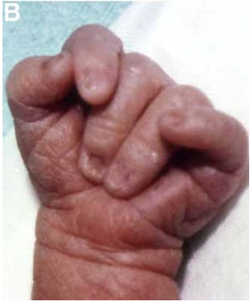
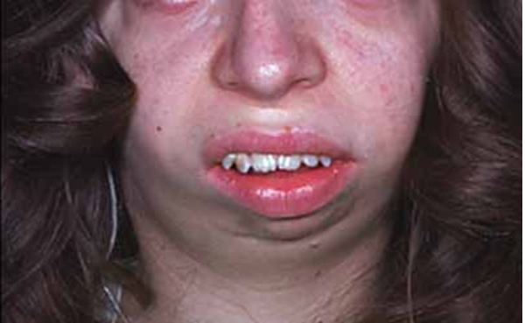
Case #7
Female infant with a single umbilical artery.
Profound psychomotor delay, mental retardation, hypotonia, and seizures
Low birth weight, microcephaly, micrognathia, closed fists with overlapping fingers.

Slide 70
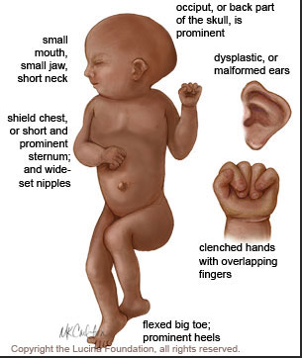
Case #7
There is microcephaly, cerebellar hypoplasia, microopthalmia, low set, malformed ears, and a short sternum
3/6 holosystolic murmur LLSB

Slide 71
What is the likelihood of congenital heart disease in this child?
(A) under 5%
(B) 10%
(C) 20%
(D) 50%
(E) Over 90%

Slide 72
What is the most likely genetic condition?
(A) Trisomy 18
(B) Trisomy 13
(C) Wolf-Hirchhorn Syndrome
(D) Rett syndrome
(E) Prader Willi

Slide 73
Trisomy 18
Additional malformations include
Pulmonary hypoplasia
GI abnormalities
GU abnormalities
Endocrine
Thymic, thyroid, and adrenal hypoplasia

Slide 74
Trisomy 18
Most common cardiac problems
VSD, ASD, PDA, TOF, coarctation of aorta, bicuspid aortic or pulmonary valve

Slide 75
Case #8
6 year-old short boy, WCC
CV: Early systolic click at USB, followed by a 3/6 SEM at LUSB.

Slide 76
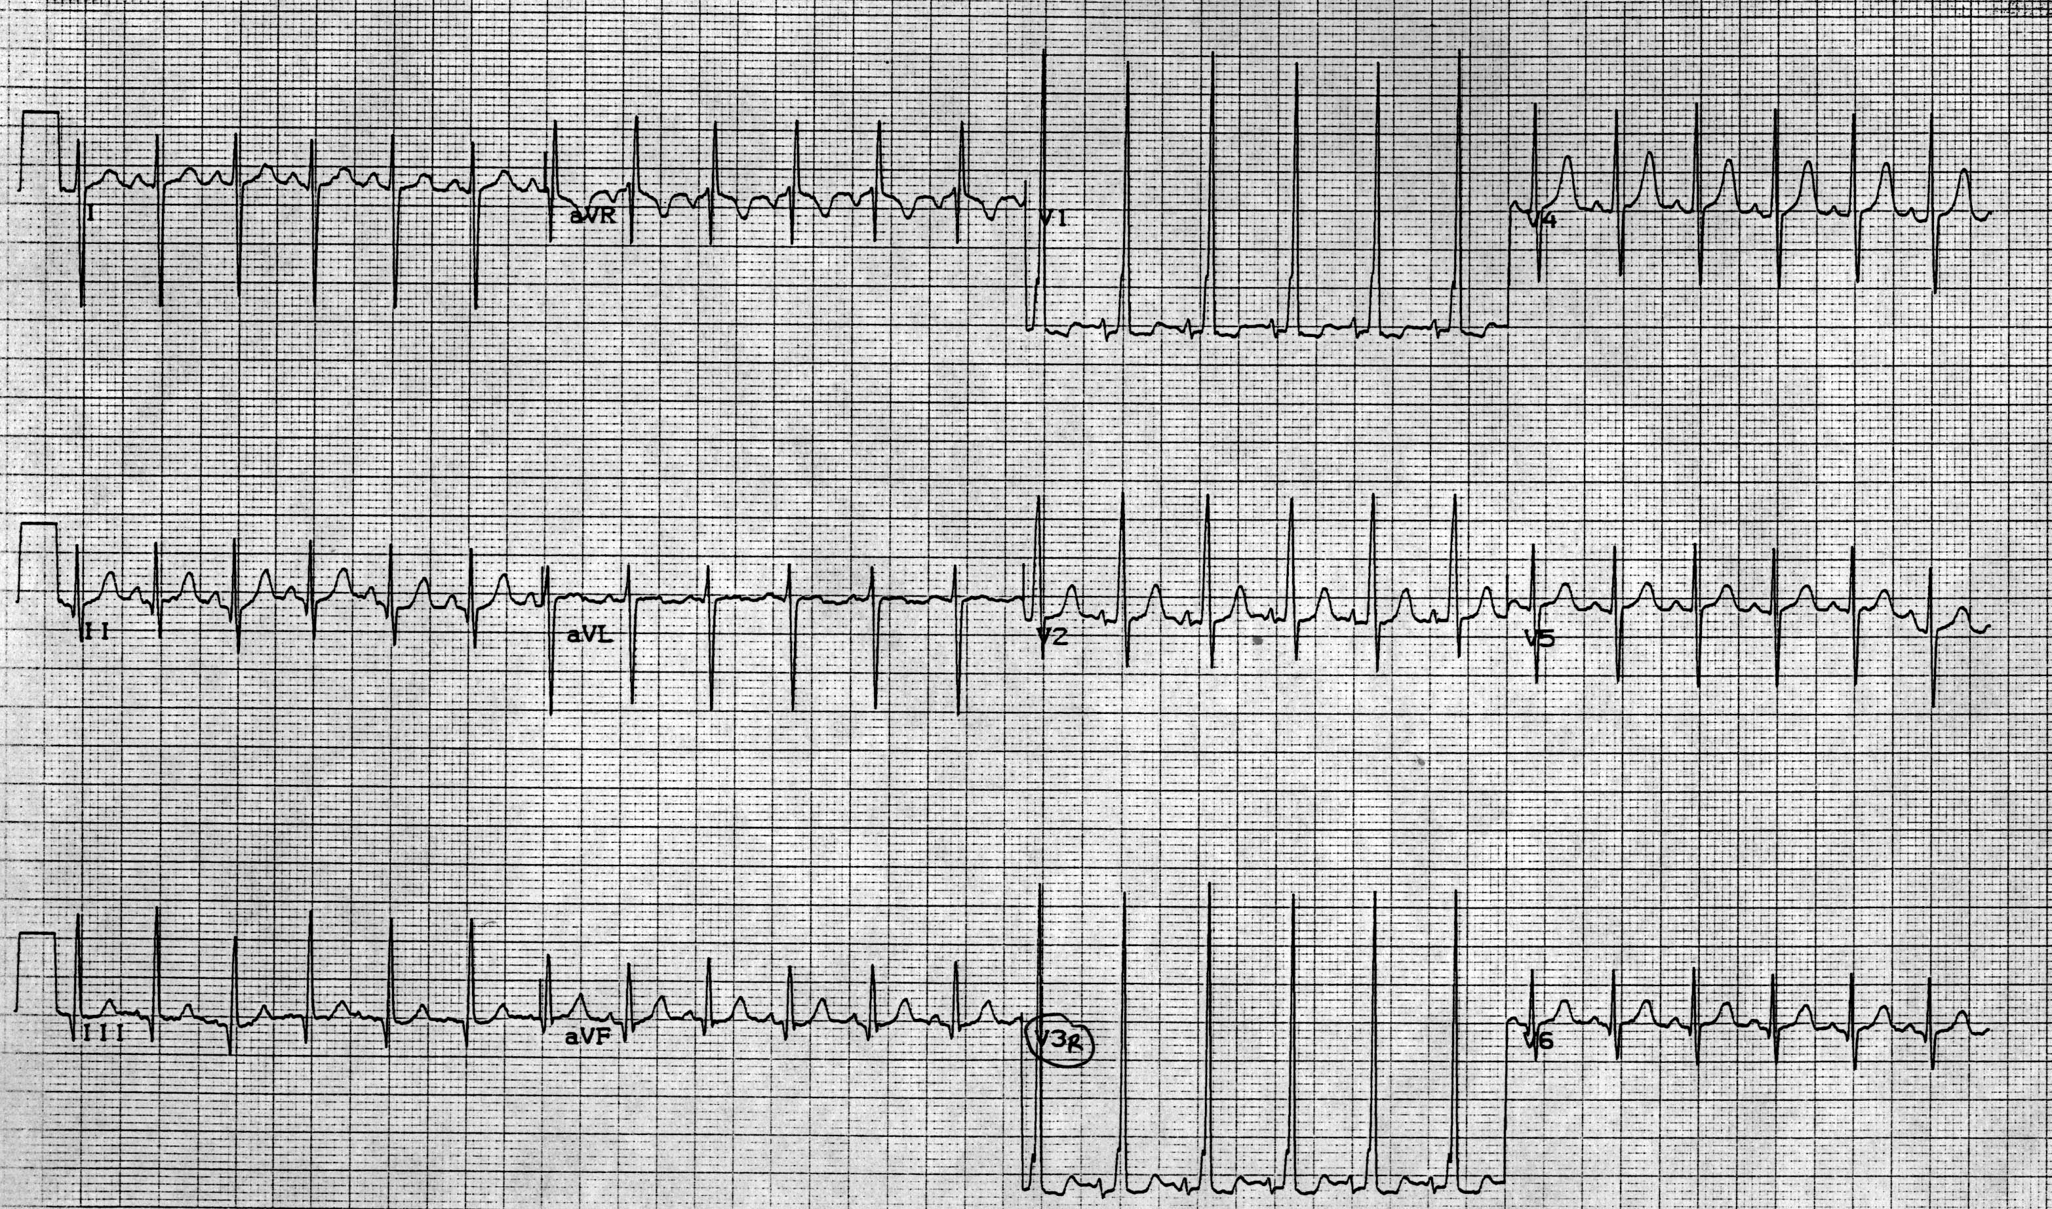

Slide 77
Which of the following is the most likely cardiac defect?
(A) Aortic stenosis
(B) VSD
(C) ASD
(D) Pulmonary stenosis
(E) PDA

Slide 78
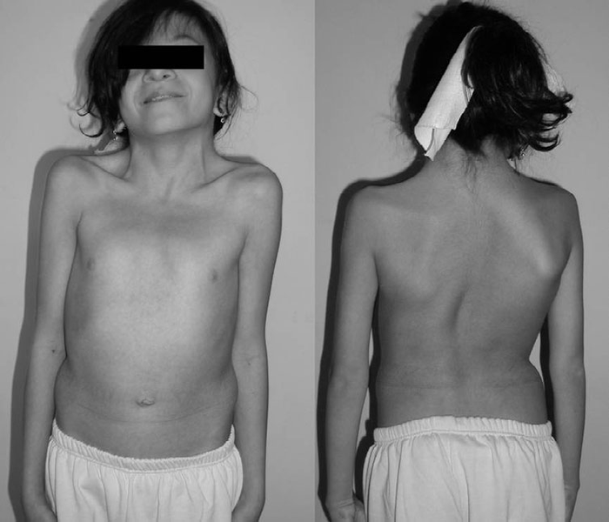

Slide 79
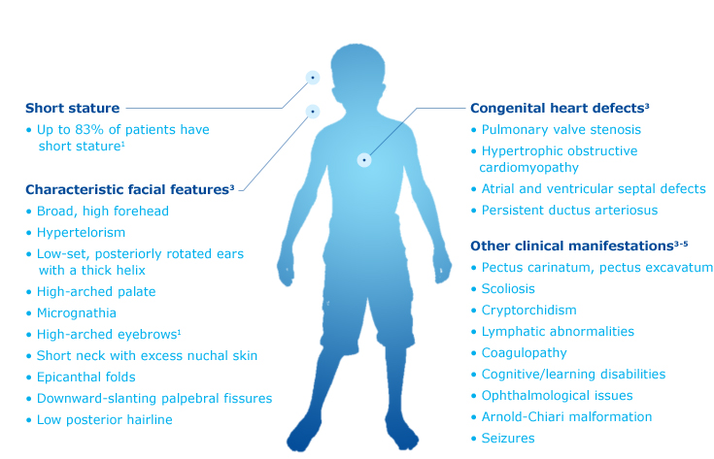

Slide 80
Which of the following is the most likely diagnosis?
(A) Leopard syndrome
(B) Noonan syndrome
(C) Klippel-Feil syndrome
(D) Lesch-Nyhan syndrome
(E) Menkes disease

Slide 81
Genetics in Noonan Syndrome
Mutation in PTPN11 (50%), SOS1 (13%)

Slide 82
Genetic defects
Pulmonary stenosis (20-50%)
HCM (20-30%)
EKG abnormalities (90%)
Axis deviation most common

Slide 83


Neonatal features
Tall forehead
Hypertelorism
Downslanting palpebral fissures
Posteriorly rotated ears

Slide 84
Case #9
12 year-old short female WCC
PE:
Apical ejection click,
2/6 SEM base that radiates to the carotids

Slide 86
Which of the following is the most likely cardiac defect?
(A) Aortic stenosis
(B) VSD
(C) ASD
(D) Pulmonary stenosis
(E) PDA

Slide 87


Slide 88
What is the most likely genetic defect?
(A) Turner syndrome
(B) VATER
(C) Treacher-Collins
(D) Stickler syndrome
(E) Sotos syndrome

Slide 89
Your Diagnosis
Turner Syndrome

Slide 90
Turner syndrome
Caused by a complete or partial X chromosome monosomy.
Risk of developing gonadoblastoma

Slide 91
Turner syndrome
Congenital heart defects (30%)
Coarctation of the aorta
Bicuspid aortic valve
Aortic stenosis
Aortic root dilation (aneurysm)

Slide 92
Case #10
12 year old boy with a history of syncope.
Family history is significant for a father who drowned unexpectedly while at swimming. He was a member of the varsity swim team.
Paternal uncle has a history of syncope.
Paternal grandfather with a history of sudden death from unknown causes at 22 years of age.

Slide 93

Long QT syndrome
Notes:
Long QTc

Slide 94
Which of the following is the most likely diagnosis?
(A) Hypertrophic cardiomyopathy
(B) Anomalous left coronary artery from the pulmonary artery
(C) Brugada syndrome
(D) Wolf Parkinson White
(E) Jervell and Lange-Nielsen syndrome

Slide 95
Long QT syndrome
QT(sec)
= 0.66 / 0.84 = 0.72
QTc =
R-R (sec)
Bazette Formula
0.84
0.66
Notes:
Long QTc

Slide 96
Jervell and Lange-Nielsen syndrome
Deaf child who experiences syncopal episodes during periods of stress, exercise, or fright.
Autosomal recessive
Profound bilateral sensorineural hearing loss and long QTc, usually greater than 500 msec.

Slide 97
Romano-Ward syndrome
Autosomal Dominant, and not associated with deafness.

Slide 98
Case #11
Large tongue, flabby muscles, cardiomegaly, and the following EKG.

Slide 99


Slide 100


Slide 101
Which of the following is the most likely diagnosis?
(A) Wolf-Hirschorn
(B) Waardenburg
(C) Pompe’s
(D) Beckwith-Wiedemann
(E) Cri-Du-Chat

Slide 102
Pompe Disease
SR glycogen storage disorder with deficiency of the enzyme acid a-glucosidase
Infantile-onset form characterized by hypotonia, cardiomegaly, and hepatomegaly
Specific EKG, echocardiography, and muscle biopsy findings.
Enzyme replacement therapy has greatly transformed the quality of life and survival of these patients.

Slide 103

Thank you!

